Slide 1
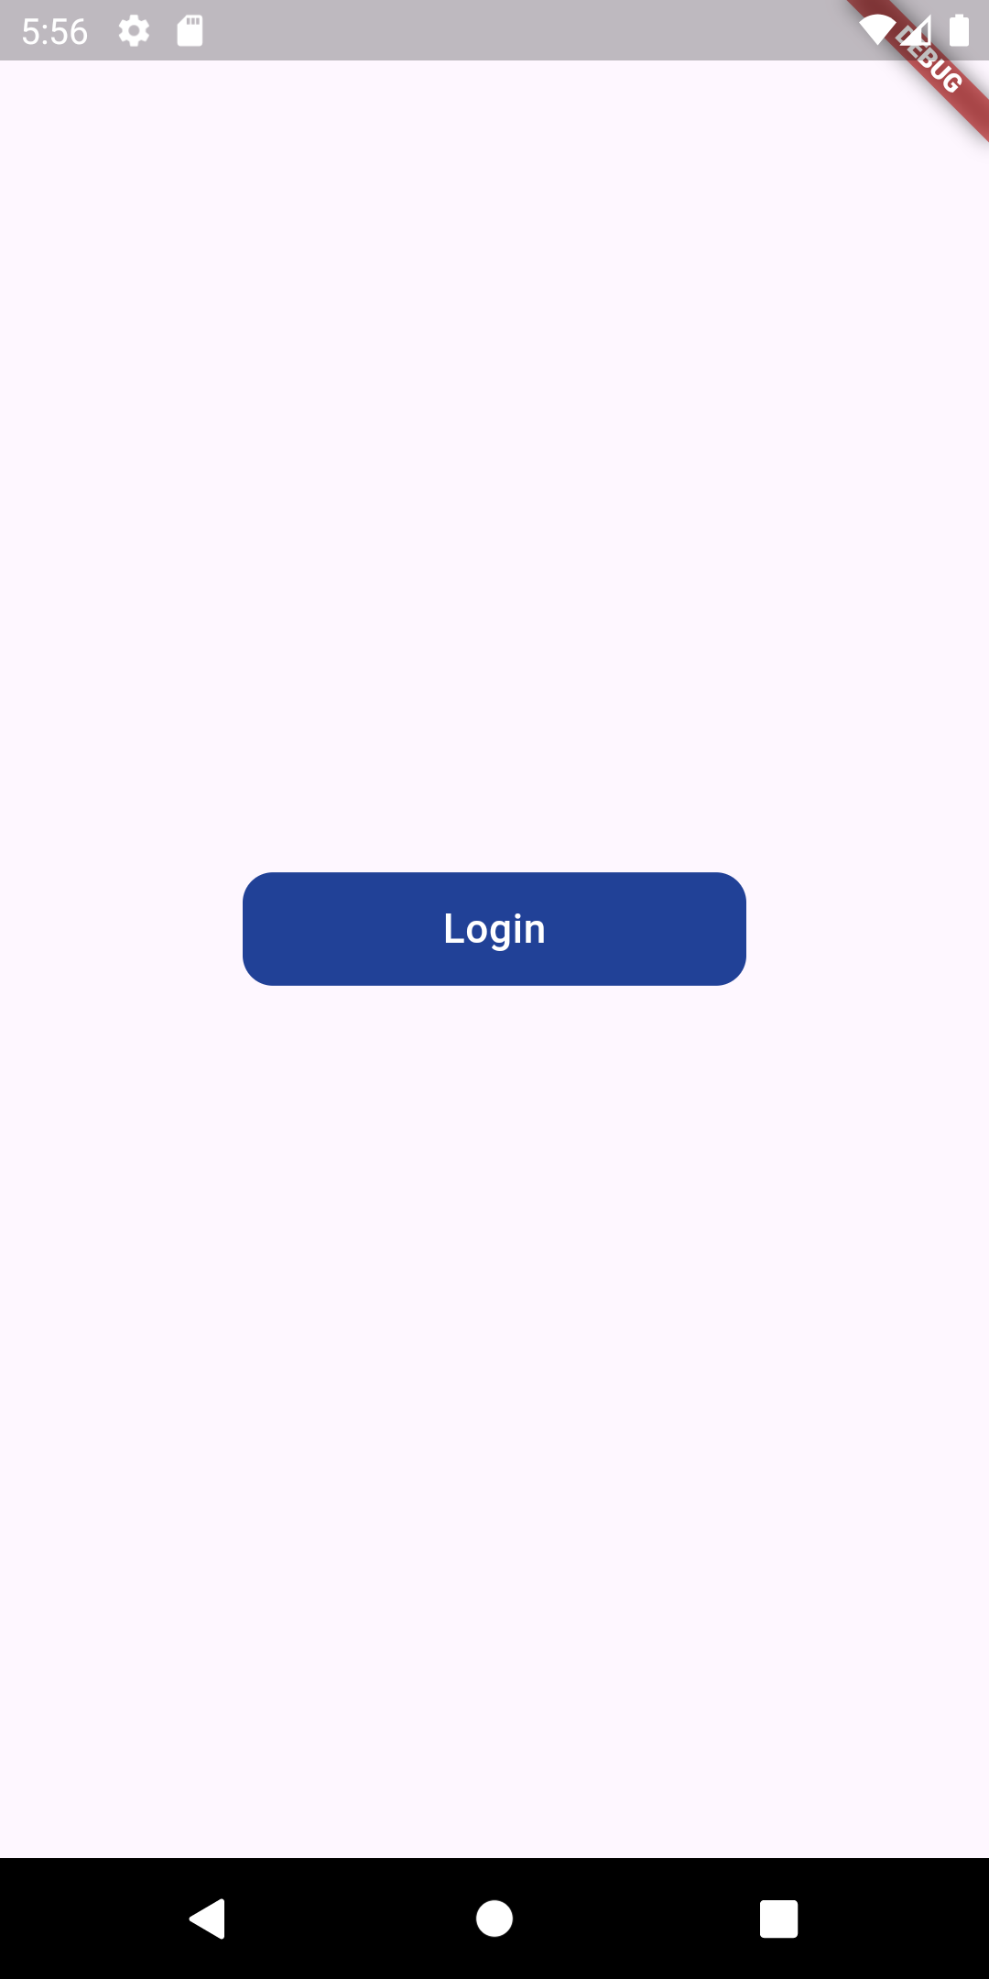
Task 1 Achieve the same result
Container
Width : 45, height 200, color code : 0xff214197
Text
Color : white, fontSize : 16, FontWeight:w500
NOTE: You see that the Container is rounded, search how to give
Border radius for Containers
borderRadious value is 12

Slide 2
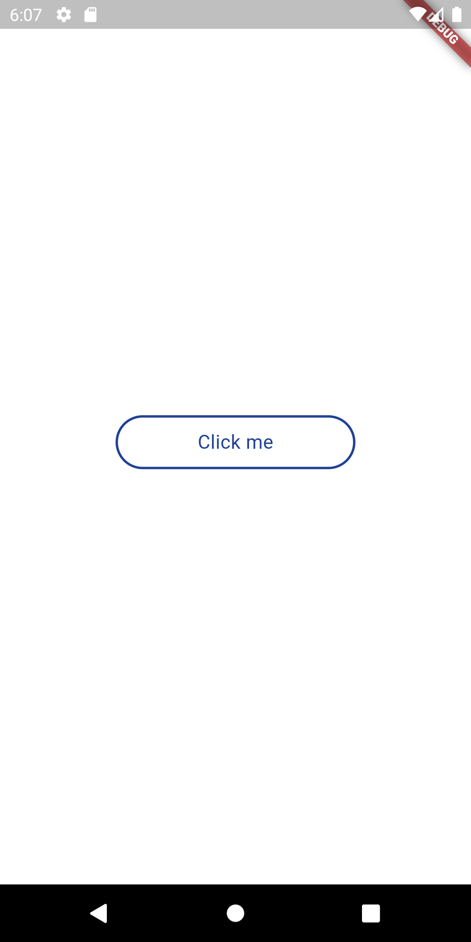
Task 2 Achieve the same result
Container
Width : 45, height 200, color code : 0xff214197
Text
Color : : 0xff214197, fontSize : 16, FontWeight:w500
NOTE: You see there is a border around the container, search
For how to give containers Border
Border Color : 0xff214197, width : 2

Slide 3
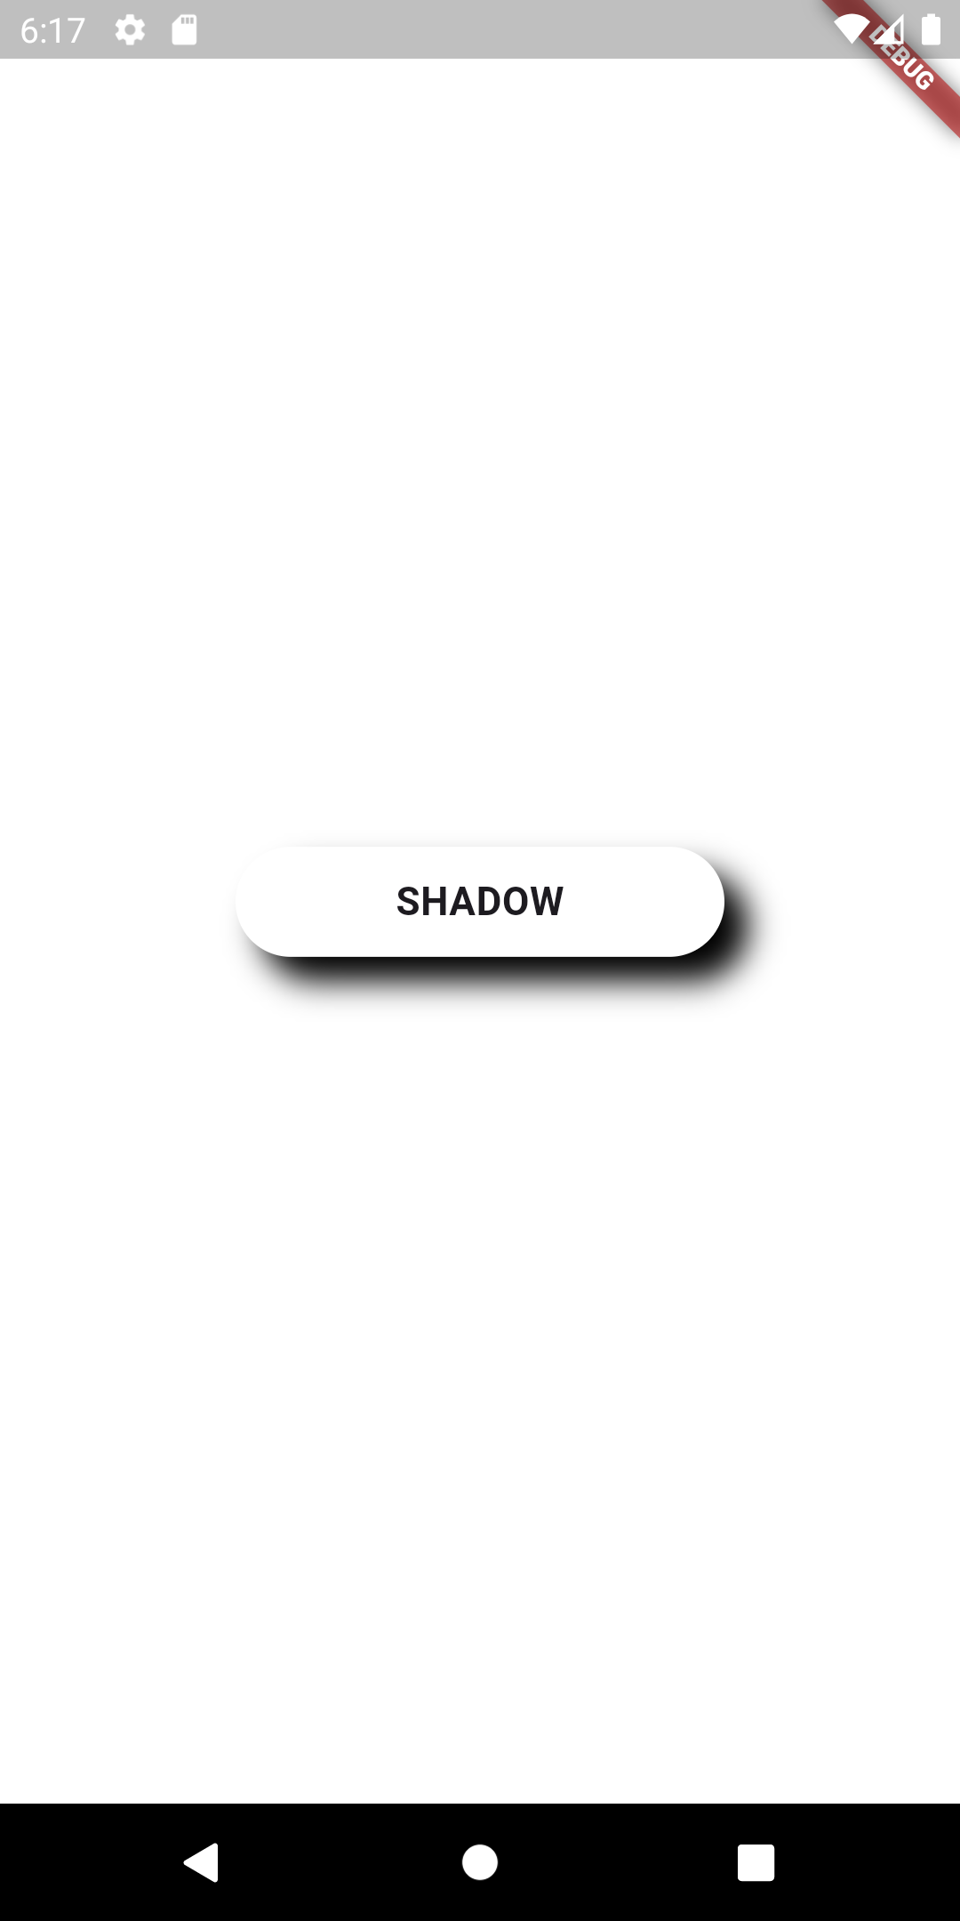
Task 3 Achieve the same result
Container
Width : 45, height 200, color: white
Text
Color : : black, fontSize : 16, FontWeight:bold
Search for how to give shadow to Container
Color : black, offset : x = 10,y = 10,
Blur radius : 10
NOTE : that black color is a little rough for the eye
Search for a way to make it a little transparent

Slide 4
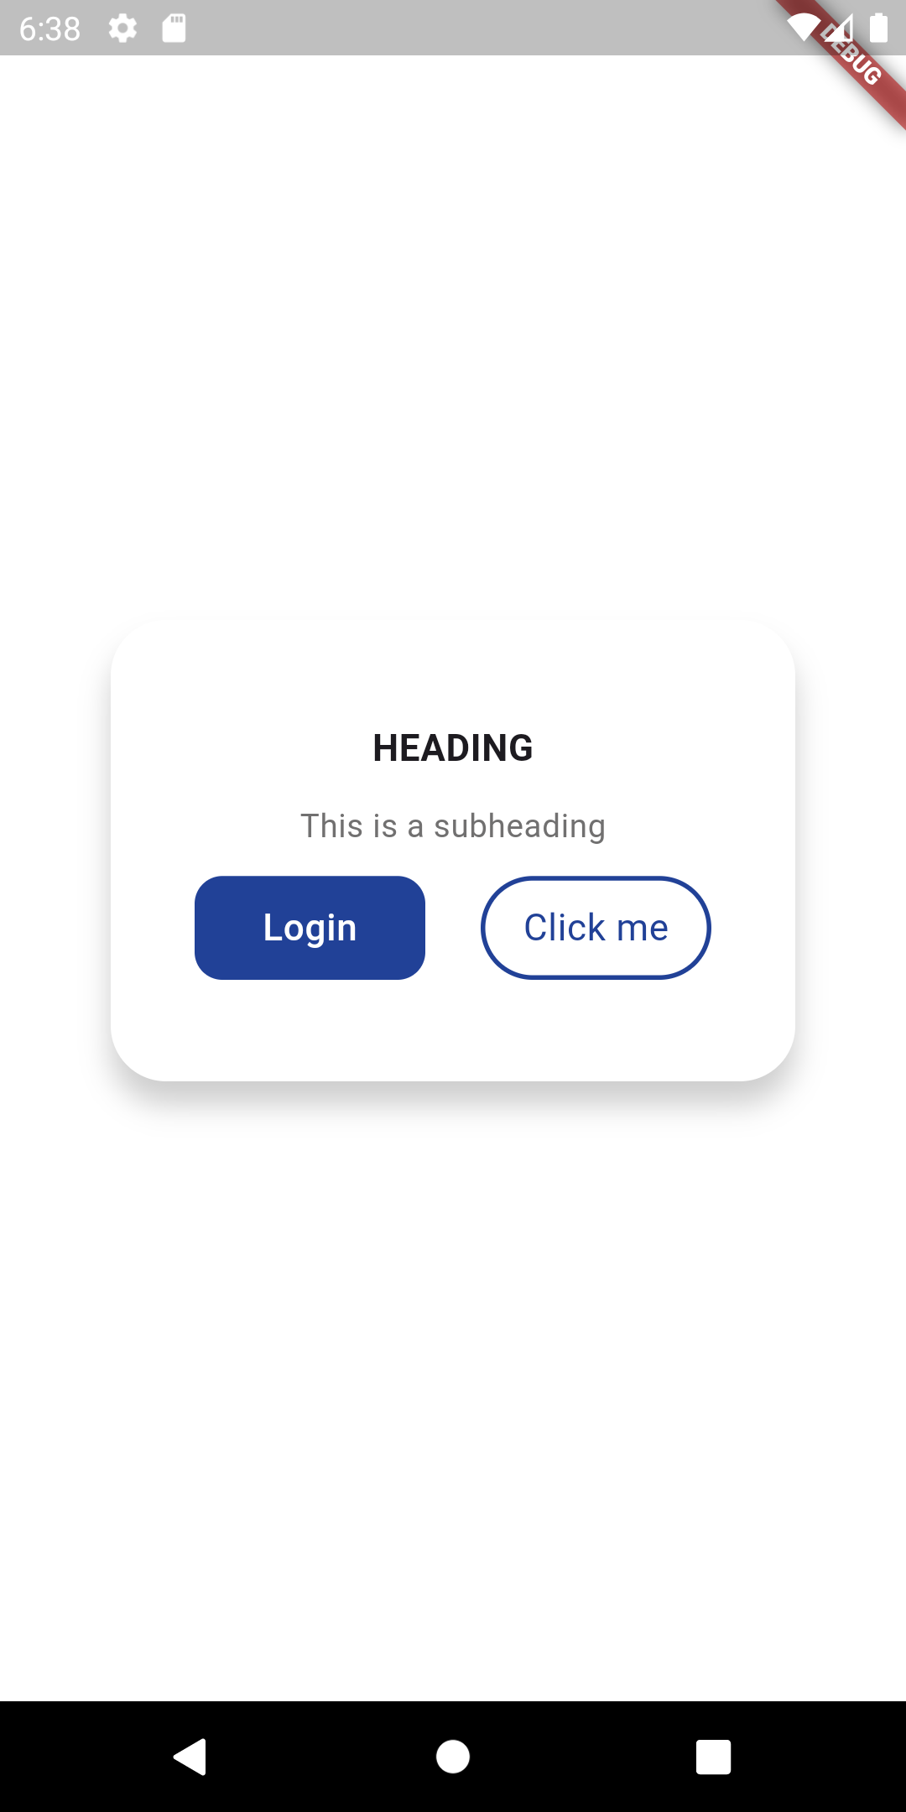
Task 4 Extra Achieve the same result
Container
Width : 500, height 200, color: white, borderRadius : 24
Shaodow : x = 0, y = 10, blurRadius : 10
shadow Color : Colors.black.withAlpha(50)
Heading => fontsize : 16, font weigth : FontWeight.w700
Subheading : 14, color 0xFF717070
Put the two the buttons from task 1 and task 2 beside
One another, just reduce their width to 100

